Slide 1
The Bulk Forming Processes: Extrusion and Deep Drawing
Lecture 15

Slide 2
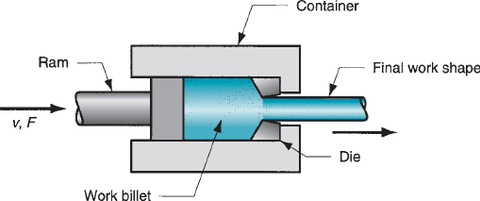
Extrusion
Extrusion: a bulk forming process in which the work metal is forced or compressed to flow through a die hole to produce a desired cross-sectional shape.
Example: squeezing toothpaste from a toothpaste tube.
Advantages :
A variety of shapes are possible, especially using hot extrusion
Grain structure and strength properties are enhanced in cold and warm extrusion
Close tolerances are possible, mainly in cold extrusion

Slide 3
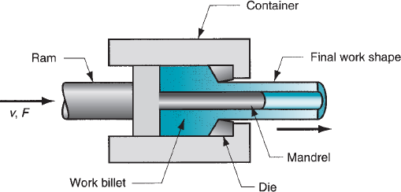

Types of Extrusion
Direct or forward extrusion
A metal billet is first loaded into a container having die holes.
A ram compresses the material, forcing it to flow through the die holes.
Some extra portion of the billet will be present at the end of the process that cannot be extruded and is called the butt.
It is separated from the product by cutting it just beyond the exit
Hollow sections like tubes can be made using direct extrusion.
The starting billet is prepared with a hole parallel to its axis.
As the billet is compressed, the material will flow through the gap between the mandrel and the die opening.
Making hollow shapes using direct extrusion

Slide 4
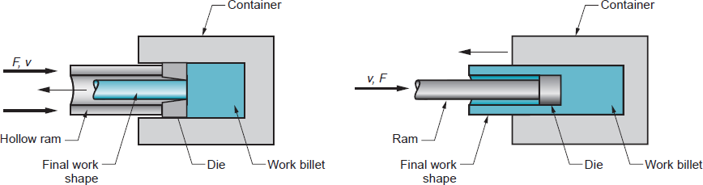
Indirect extrusion: solid billet and hollow billet
Types of Extrusion
Indirect Extrusion
In this type, the die is mounted to the ram and not on the container.
As the ram compresses the metal, it flows through the die hole on the ram side, which is in the opposite direction to the movement of the ram.
There is no relative motion between the billet and the container; there is no friction at the interface, and hence the ram force is lower than in direct extrusion.
Limitations: lower rigidity of the hollow ram, difficulty in supporting the extruded product at the exit

Slide 5
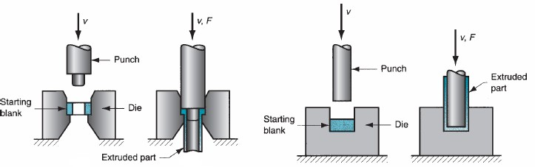
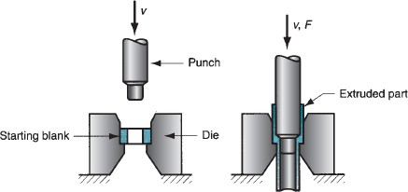
Other Extrusion Processes
Impact Extrusion:
It is performed at higher speeds and shorter strokes. The billet is extruded through the die by impact pressure and not just by applying pressure.
Impacting can be carried out as forward extrusion, backward extrusion, or a combination of these.
Forward extrusion
Backward extrusion
Combined extrusion

Slide 6
Impact Extrusion
Impact extrusion is carried out as cold forming.
Very thin walls are possible by the backward impact extrusion method.
Examples: making toothpaste tubes, battery cases.
Advantages of Impact Extrusion:
large reductions and high production rates

Slide 7
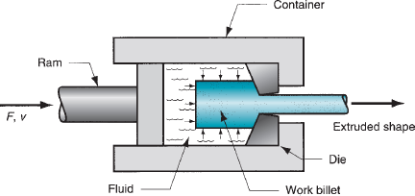
Hydrostatic Extrusion
In hydrostatic extrusion, the billet is surrounded with fluid inside the container, and the forward motion of the ram pressurizes the fluid.
There is no friction inside the container because of the fluid, and friction is minimized at the die opening. If used at high temperatures, special fluids and procedures must be followed.
In the absence of friction, hydrostatic pressure on the work increases the material’s ductility.
This process can be used on metals that would be too brittle for conventional extrusion methods.
This process is also applicable for ductile metals, and here, high reduction ratios are possible.
The billet must be formed with a taper at one end to fit tightly into the die entry angle.
Hydrostatic extrusion

Slide 8
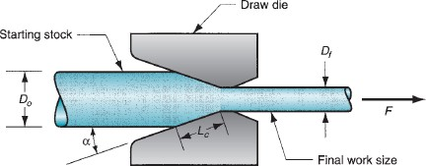
Wire, Rod, Bar Drawing
In this bulk forming process, a wire, rod, or bar is pulled through a die hole, reducing its cross-sectional area.
Difference between wire drawing and rod drawing
Initial stock size:
The basic difference between bar drawing and wire drawing is the stock size that is used for forming.
Bar drawing is meant for large diameter bar and rod, while wire drawing is meant for small diameter stock.
Wire sizes of the order of 0.03 mm are produced in wire drawing.
Wire, rod, bar drawing

Slide 9
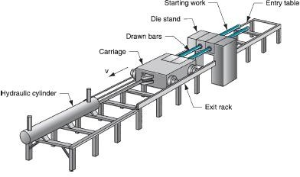
Operating Stages
Bar Drawing
Bar drawing is done as a single-stage operation, in which stock is pulled through one die opening.
The inlet bars are straight and not in the form of a coil, which limits the length of the work that can be drawn.
Drawing equipment
Drawing bar by draw bench

Slide 10
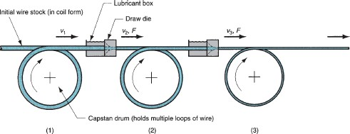
Wire Drawing
Wire is drawn from coils consisting of several hundred meters of wire and is drawn through a series of dies.
The number of dies varies between 4 and 12.
This is called ‘continuous drawing’ because of the long production runs that are achieved with the wire coils.
The segments can be butt-welded to the next to make the operation truly continuous.
Continuous drawing of wire

Slide 11

Tube Drawing
This operation is used to reduce the diameter or wall thickness of the seamless tubes and pipes.
Tube drawing can be done either with or without a mandrel.
Die
Tube
Rod
Pull force
Die
(b) Tube drawing without mandrel
(TUBE SINKING)
(a) Rod drawing
The simplest method uses no mandrel and is used for diameter reduction, called tube sinking.
But the inside diameter and wall thickness cannot be controlled. So, a mandrel is required.

Slide 12

Tube Drawing
Die
Tube
Using a fixed mandrel: In this case, a mandrel is attached to a long support bar to control the inside diameter and wall thickness during the operation. The length of the support bar restricts the length of the tube that can be drawn.
Mandrel
Tube drawing with fixed mandrel
Using a floating plug: As the name suggests, the mandrel floats inside the tube, and its shape is designed so that it finds a suitable position in the reduction zone of the die. There is no length restriction in this, as seen with the fixed mandrel.
Die
Tube
Pull force
Floating mandrel
(Tube drawing with floating mandrel

Slide 13


